Slide 1
Module 4: Requirements Engineering
Software Engineering
Faculty of Computing
Universiti Teknologi Malaysia

Slide 2
Outline
Types of Requirements
Functional and Non-Functional Requirements
Requirements Engineering Process
  Requirements Elicitation
  Requirements Specification
  Requirement Validation
  Requirement Change
Note: The overall contents of the slide are based on the main reference that is Sommerville (2016) with other references specified directly in respective slides (if any)

Slide 3
Objectives
The objectives of this module are:
To differentiate users and system requirements
To understand functional requirements (FR) and non-functional requirements (NFR)
To understand the main requirements engineering activities that are elicitation, analysis and validation
To know diverse techniques to write requirements specification
To understand the important of requirements management and how it supports requirement change.

Slide 4
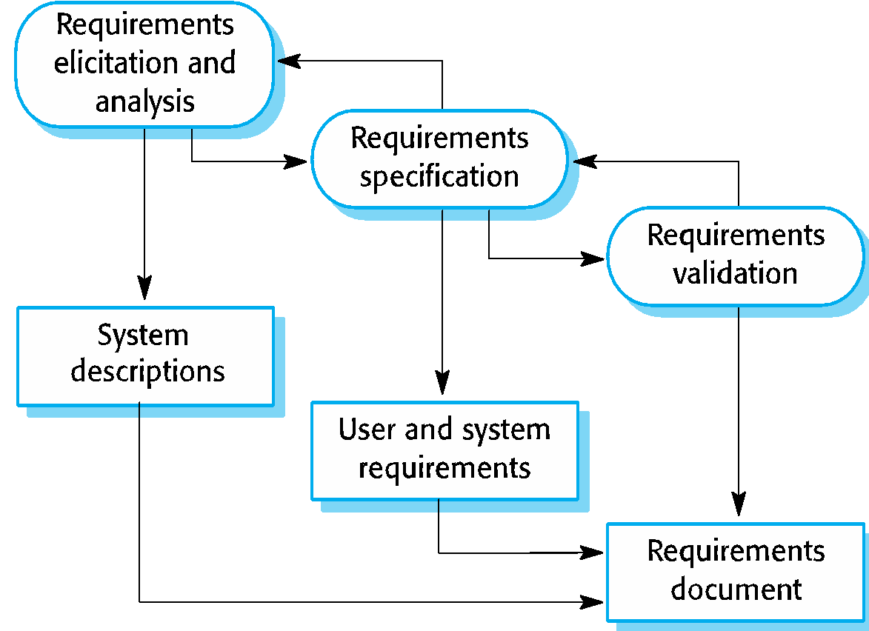
Recap: Requirements Engineering Process in Software Process Model

Slide 5
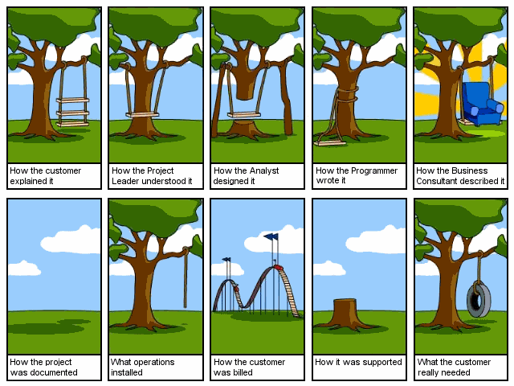
Requirements in Different Perspectives

Slide 6
Requirements Engineering
The process of establishing the services that the customer requires from a system and the constraints under which it operates and is developed.
The system requirements are the descriptions of the system services and constraints that are generated during the requirements engineering process.

Slide 7
What is a Requirement?
It may range from a high-level abstract statement of a service or of a system constraint to a detailed mathematical functional specification
This is inevitable as requirements may serve a dual function:
  May be the basis for a bid for a contract - therefore must be open to interpretation
  May be the basis for the contract itself - therefore must be defined in detail
  Both these statements may be called requirements

Slide 8
TYPE OF REQUIREMENTS

Slide 9
Types of Requirement
User requirements
  Statements in natural language plus diagrams of the services the system provides and its operational constraints
  Written for customers
System requirements
  A structured document setting out detailed descriptions of the system’s functions, services and operational constraints
  Defines what should be implemented so may be part of a contract between client and contractor

Slide 10
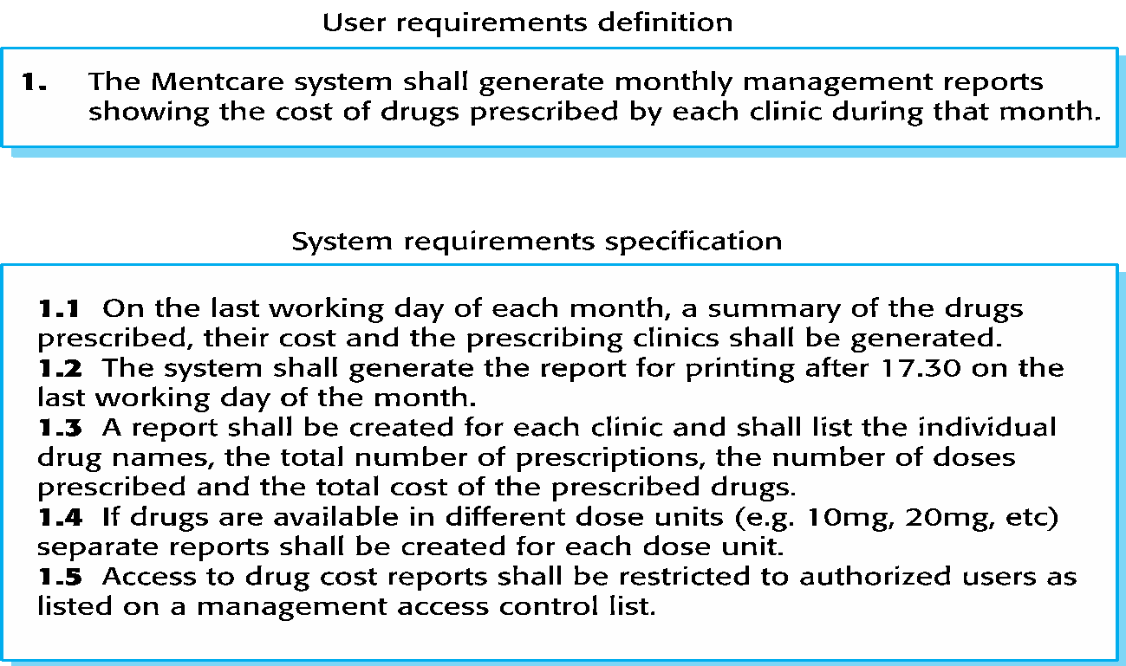
User and System Requirements

Slide 11
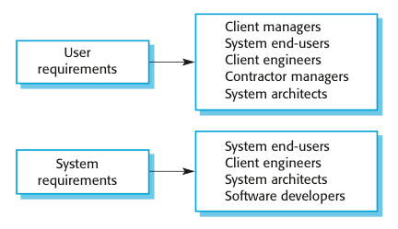


Readers of Different Types of Requirements Specification

Slide 12
FUNCTIONAL AND NON-FUNCTIONAL REQUIREMENTS

Slide 13
Functional and Non-Functional Requirements
Functional requirements (FR)
  Statements of services the system should provide, how the system should react to particular inputs and how the system should behave in particular situations
  May state what the system should not do
Non-functional requirements (NFR)
  Constraints on the services or functions offered by the system such as timing constraints, constraints on the development process, standards, etc.
  Often apply to the system as a whole rather than individual features or services
Besides FR and NFR, there are domain requirements
  Constraints on the system from the domain of operation

Slide 14
Functional Requirements
Describe functionality or system services
Depend on the type of software, expected users and the type of system where the software is used
Functional user requirements may be high-level statements of what the system should do
Functional system requirements should describe the system services in detail

Slide 15
Example: Functional Requirements in Mentcare System
A user shall be able to search the appointments lists for all clinics
The system shall generate each day, for each clinic, a list of patients who are expected to attend appointments that day
Each staff member using the system shall be uniquely identified by his or her 8-digit employee number

Slide 16
Requirements Imprecision
Problems arise when requirements are not precisely stated
Ambiguous requirements may be interpreted in different ways by developers and users
Consider the term ‘search’ in requirement 1:
  User intention: search for a patient name across all appointments in all clinics
  Developer interpretation: Search for a patient name in an individual clinic. User chooses clinic then search.
A user shall be able to search the appointments lists for all clinics

Slide 17
Requirements Completeness and Consistency
In principle, requirements should be both complete and consistent
Complete: They should include descriptions of all facilities required
Consistent: There should be no conflicts or contradictions in the descriptions of the system facilities
In practice, it is impossible to produce a complete and consistent requirements document

Slide 18
Non-Functional Requirements
These define system properties and constraints e.g. reliability, response time and storage requirements. Constraints are I/O device capability, system representations, etc.
Process requirements may also be specified mandating a particular Integrated Development Environment (IDE), programming language or development method
Non-functional requirements may be more critical than functional requirements. If these are not met, the system may be useless

Slide 19
Non-Functional Classifications
Product requirements
  Requirements which specify that the delivered product must behave in a particular way e.g. execution speed, reliability, etc.
Organisational requirements
  Requirements which are a consequence of organisational policies and procedures e.g. process standards used, implementation requirements, etc.
External requirements
  Requirements which arise from factors which are external to the system and its development process e.g. interoperability requirements, legislative requirements, etc.

Slide 20
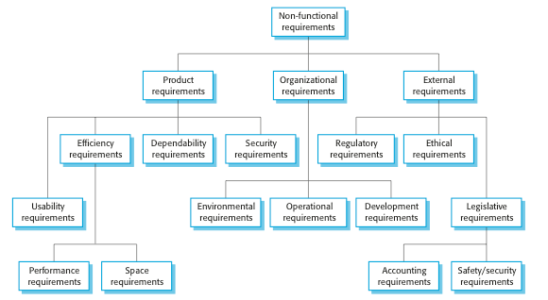
Types of Non-Functional Requirements
POE
UEDS
REL
EOD
PS
AS

Slide 21
Non-Functional Requirements Implementation
Non-functional requirements may affect the overall architecture of a system rather than the individual components
  E.g. to ensure that performance requirements are met, developers may have to organize the system to minimize communications between components
A single non-functional requirement e.g. a security requirement, may generate a number of related functional requirements that define system services that are required
  It may also generate requirements that restrict existing requirements

Slide 22
Examples of Non-Functional Requirements in the Mentcare System
Product requirement The Mentcare system shall be available to all clinics during normal working hours (Mon–Fri, 0830–17.30). Downtime within normal working hours shall not exceed five seconds in any one day. Organizational requirement Users of the Mentcare system shall authenticate themselves using their health authority identity card. External requirement The system shall implement patient privacy provisions as set out in HStan-03-2006-priv.

Slide 23
Goals and Requirements
Non-functional requirements may be very difficult to state precisely and imprecise requirements may be difficult to verify
Goal: A general intention of the user such as ease of use
Verifiable non-functional requirement: A statement using some measures that can be objectively tested
Goals are helpful to developers as they convey the intentions of the system users

Slide 24
Example: Usability Requirements
The system should be easy to use by medical staff and should be organized in such a way that user errors are minimized. (Goal)
Medical staff shall be able to use all the system functions after four hours of training. After this training, the average number of errors made by experienced users shall not exceed two per hour of system use. (Testable non-functional requirement)

Slide 25
Metrics for Measuring Non-Functional Requirements
Metrics | Measure
Speed | Processed transactions/second User/event response time Screen refresh time
Size | Mbytes Number of ROM chips
Ease of use | Training time Number of help frames
Reliability | Mean time to failure Probability of unavailability Rate of failure occurrence Availability
Robustness | Time to restart after failure Percentage of events causing failure Probability of data corruption on failure
Portability | Percentage of target dependent statements Number of target systems

Slide 26
Domain Requirements
System’s operational domain imposes requirements on the system:
  E.g. a train control system has to take into account the braking characteristics in different weather conditions
Domain requirements could be new functional requirements, constraints on existing requirements or define specific computations
If domain requirements are not satisfied, the system may be unworkable

Slide 27
Example: Train Protection System
Example of a domain requirement for a train protection system: The deceleration of the train shall be computed as:
  Dtrain = Dcontrol + Dgradient
    where Dgradient is 9.81ms2 * compensated gradient/alpha and where the values of 9.81ms2 /alpha are known for different types of train.
It is difficult for a non-specialist to understand the implications of this and how it interacts with other requirements

Slide 28
Domain Requirements Problems
Understandability:
  Requirements are expressed in the language of the application domain
  This is often not understood by software engineers developing the system
Implicitness:
  Domain specialists understand the area so well that they do not think of making the domain requirements explicit

Slide 29
REQUIREMENTS ENGINEERING PROCESSES

Slide 30
Requirements Engineering Processes
The processes used for RE vary widely depending on the application domain, the people involved and the organisation developing the requirements
However, there are a number of generic activities common to all processes:
  Requirements elicitation and analysis
  Requirements specification
  Requirements validation
  Requirements change
In practice, RE is an iterative activity in which these processes are interleaved

Slide 31
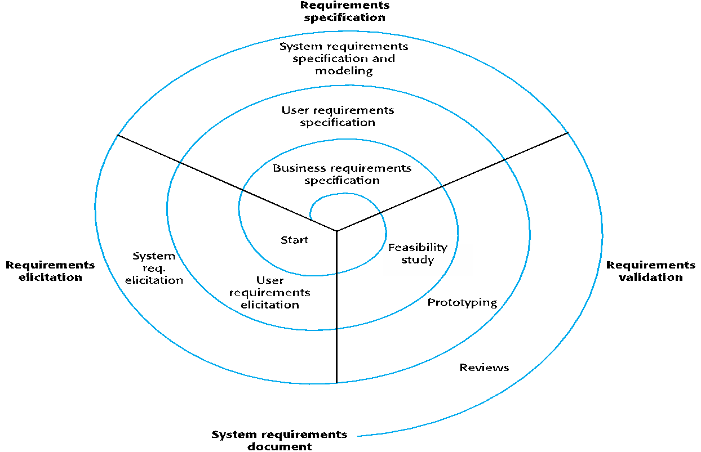
A Spiral View: Requirements Engineering Processes

Slide 32
Requirements Engineering Processes
Requirements Elicitation and Analysis
Requirements Specification
Requirements Validation
Requirements Change

Slide 33
Requirements Elicitation and Analysis
Sometimes called requirements elicitation or requirements discovery
Involves technical staff working with customers to find out about the application domain, the services that the system should provide and the system’s operational constraints
May involve end-users, managers, engineers involved in maintenance, domain experts, trade unions, etc. these are called stakeholders

Slide 34
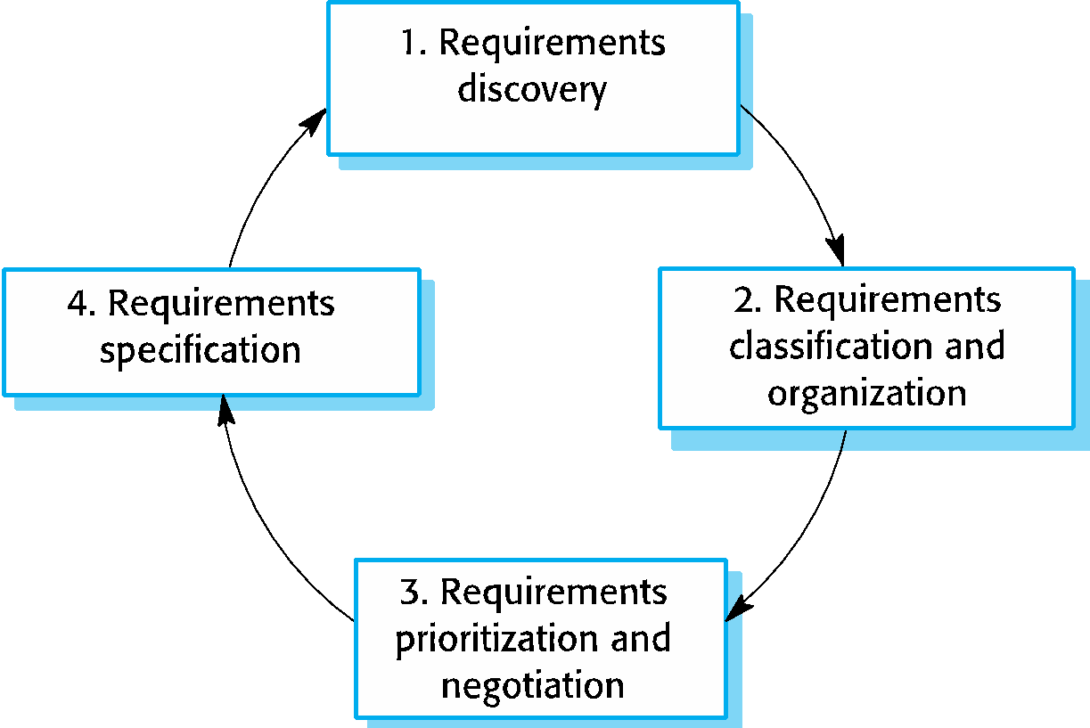
Requirements Elicitation and Analysis
Software engineers work with a range of system stakeholders to find out about the application domain, the services that the system should provide, the required system performance, hardware constraints, other systems, etc.
Stages include:
  Requirements discovery
  Requirements classification and organization
  Requirements prioritization and negotiation
  Requirements specification

Slide 35
Problems of Requirements Elicitation
Stakeholders do not know what they really want
Stakeholders express requirements in their own terms
Different stakeholders may have conflicting requirements
Organisational and political factors may influence the system requirements
The requirements change during the analysis process. New stakeholders may emerge and the business environment change
Therefore, there are range of techniques

Slide 36
Requirements Elicitation and Analysis: Process Activities
Requirements discovery
  Interacting with stakeholders to discover their requirements
  Domain requirements are also discovered at this stage
Requirements classification and organisation
  Groups related requirements and organises them into coherent clusters
Prioritisation and negotiation
  Prioritising requirements and resolving requirements conflicts
Requirements specification
  Requirements are documented and input into the next round of the spiral

Slide 37
Requirements Discovery
The process of gathering information about the required and existing systems and distilling the user and system requirements from this information
Sources of information during requirements discovery phase:
  Documentation
  System stakeholders
  Specification from similar systems
Systems normally have a range of stakeholders.

Slide 38
System stakeholders
Any person or organization who is affected by the system in some way and so who has a legitimate interest.
Stakeholders types
  End users
  System managers
  System owners
  External stakeholders

Slide 39
Example: Stakeholders in the Mentcare System
Patients whose information is recorded in the system.
Doctors who are responsible for assessing and treating patients.
Nurses who coordinate the consultations with doctors and administer some treatments.
Medical receptionists who manage patients’ appointments.
IT staff who are responsible for installing and maintaining the system.

Slide 40
Example: Stakeholders in the Mentcare System
A medical ethics manager who must ensure that the system meets current ethical guidelines for patient care
Health care managers who obtain management information from the system
Medical records staff who are responsible for ensuring that system information can be maintained and preserved, and that record keeping procedures have been properly implemented

Slide 41
User Characteristics and Personas
RE-related tasks involve end-users in the process
The more users involvements, the greater the likelihood that the requirements specifications will satisfy the users
User Characteristics and Personas are versatile tools and can be used in all RE-related tasks
Notes:
Added oct 2025

Slide 42
User Characteristics
Attributes of the types of users who will interact with the system.
    skill level (novice vs expert)
    frequency of use (occasional vs heavy user)
    environment (mobile, desktop, in-office, field)
    accessibility requirements (vision/hearing/physical limitations)
    educational background, language proficiency, etc.
more high-level, abstract compare to Persona
Notes:
Added oct 2025

Slide 43
Personas
A more detailed fictional representation of a user type — a profile that includes name, background, motivations, goals, behaviours, pain-points, etc.
Example :
  “Maria, 45-year school teacher, uses the system twice a day, low comfort with new software, needs fast onboarding..”
Notes:
Added oct 2025

Slide 44
Techniques to Elicit Requirements
Interviewing: for formal or informal interview with stakeholders
Ethnography: to observe operational process in the organization
Stories and Scenarios: representing real life examples

Slide 45
Interviewing
Formal or informal interviews with stakeholders are part of most RE processes.
Types of interview:
  Closed interviews based on pre-determined list of questions
  Open interviews where various issues are explored with stakeholders
Effective interviewing:
  Be open-minded, avoid pre-conceived ideas about the requirements and are willing to listen to stakeholders

Slide 46
Interviews in Practice
Normally a mix of closed and open-ended interviewing.
Interviews are good for getting an overall understanding of what stakeholders do and how they might interact with the system
Interviewers need to be open-minded without pre-conceived ideas of what the system should do.

Slide 47
Problems with Interviews
Application specialists may use language to describe their work that isn’t easy for the requirements engineer to understand.
Interviews are not good for understanding domain requirements:
  Requirements engineers cannot understand specific domain terminology
  Some domain knowledge is so familiar that people find it hard to articulate or think that it is not worth articulating

Slide 48
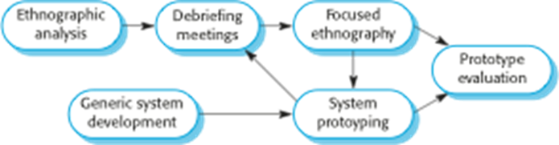
Ethnography
A social scientist spends a considerable time observing and analysing how people actually work
People do not have to explain or articulate their work
Social and organisational factors of importance may be observed
Ethnographic studies have shown that work is usually richer and more complex than suggested by simple system models

Slide 49
Scope of Ethnography
Requirements that are derived from the way that people actually work rather than the way which process definitions suggest that they ought to work
Requirements that are derived from cooperation and awareness of other people’s activities
  Awareness of what other people are doing leads to changes in the ways in which we do things
Ethnography is effective for understanding existing processes but cannot identify new features that should be added to a system

Slide 50
Stories and Scenarios
Scenarios and user stories are real-life examples of how a system can be used.
Scenarios is a structured form of user story.
Scenarios should include:
  A description of the starting situation
  A description of the normal flow of events
  A description of what can go wrong
  Information about other concurrent activities
  A description of the state when the scenario finishes

Slide 51
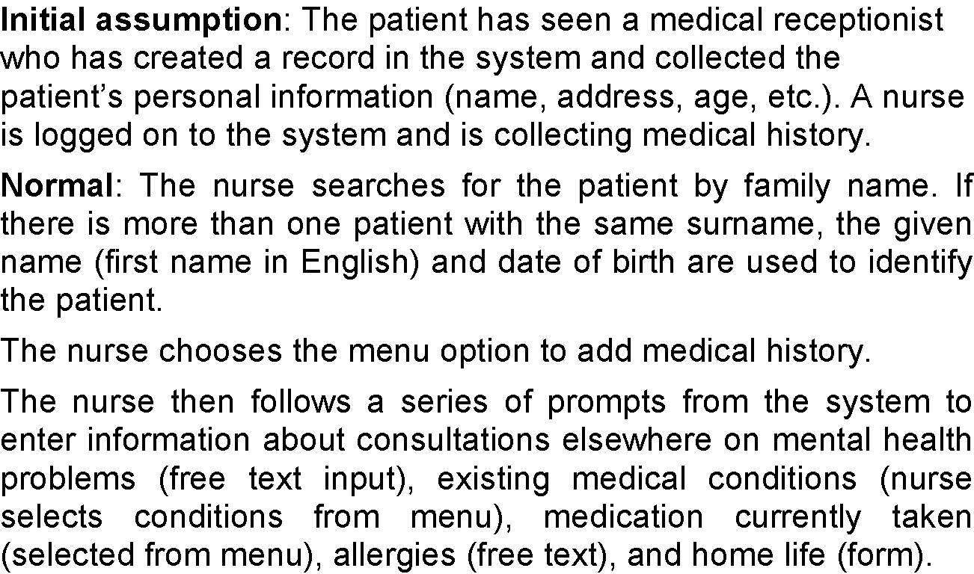
Scenario for Collecting Medical History in Mentcare System

Slide 52
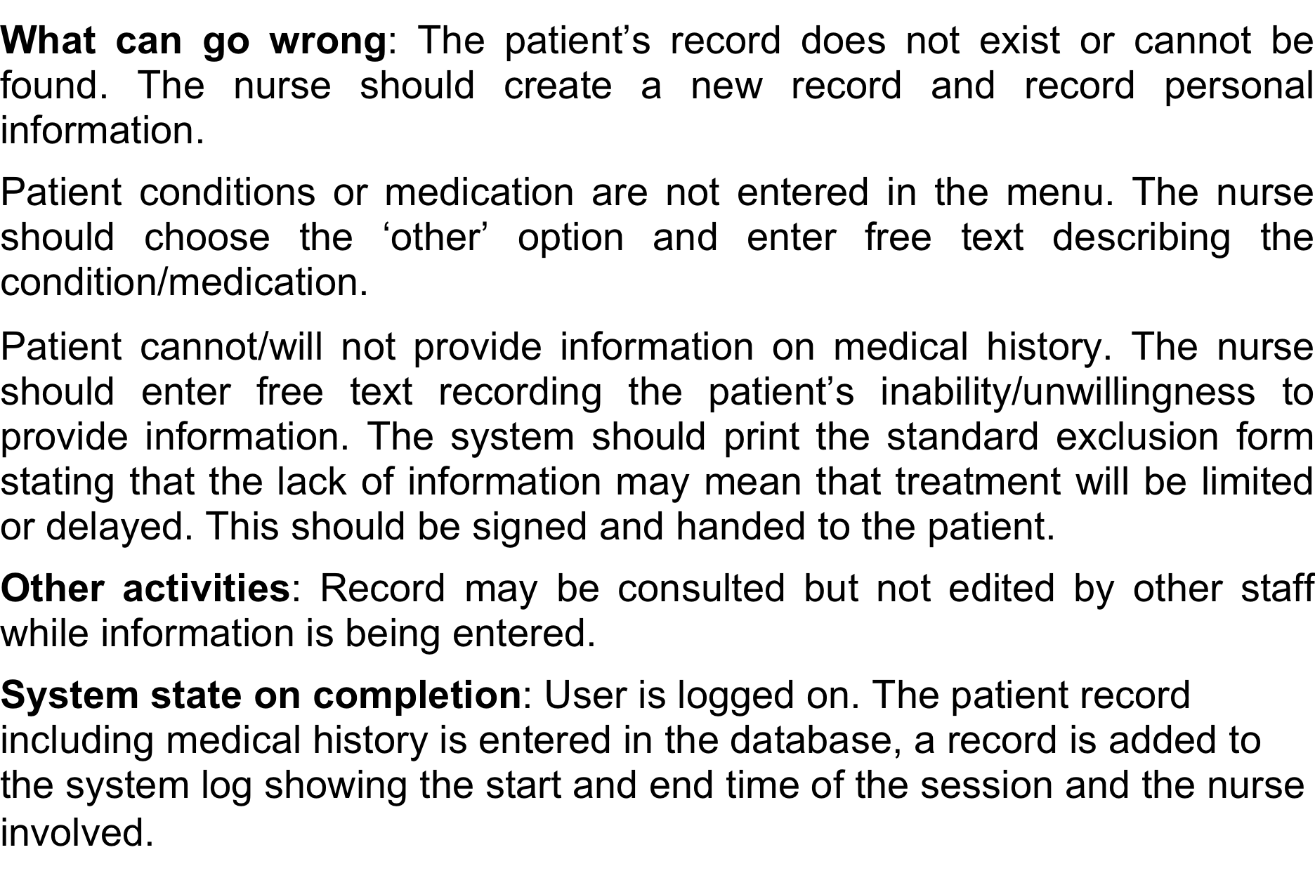
Scenario for Collecting Medical History in Mentcare System

Slide 53
Requirements Engineering Processes
Requirements Elicitation and Analysis
Requirements Specification
Requirements Validation
Requirements Change

Slide 54
Requirements Specification
The process of writing down the user and system requirements in a requirements document.
User requirements have to be understandable by end-users and customers who do not have a technical background
System requirements are more detailed requirements and may include more technical information
The requirements may be part of a contract for the system development, thus it is important that these are as complete as possible

Slide 55
Software Requirements Document
The software requirements document is the official statement of what is required of the system developers - sometimes called the Software Requirement Specification (SRS).
Should include both a definition of user requirements and a specification of the system requirements
It is NOT a design document
As far as possible, it should set of WHAT the system should do rather than HOW it should do it

Slide 56
Agile Methods and Requirements
Many agile methods argue that producing a requirements document is a waste of time as requirements change so quickly
The document is therefore always out of date
Methods such as XP use incremental requirements engineering and express requirements as user stories
This is practical for business systems but problematic for systems that require a lot of pre-delivery analysis (e.g. critical systems) or systems developed by several teams

Slide 57
Ways of Writing a System Requirements Specification
Notation | Description
Natural language | The requirements are written using numbered sentences in natural language. Each sentence should express one requirement.
Structured natural language | The requirements are written in natural language on a standard form or template. Each field provides information about an aspect of the requirement.
Design description language | This approach uses a language like a programming language, but with more abstract features to specify the requirements by defining an operational model of the system. This approach is now rarely used although it can be useful for interface specifications.
Graphical notations | Graphical models, supplemented by text annotations, are used to define the functional requirements for the system; UML use case and sequence diagrams are commonly used.
Mathematical specifications | These notations are based on mathematical concepts such as finite-state machines or sets. Although these unambiguous specifications can reduce the ambiguity in a requirements document, most customers don’t understand a formal specification. They cannot check that it represents what they want and are reluctant to accept it as a system contract.

Slide 58
Requirements and Design
In principle, requirements should state WHAT the system should do and the design should describe HOW it does this
In practice, requirements and design are inseparable:
  A system architecture may be designed to structure the requirements
  The system may inter-operate with other systems that generate design requirements
  The use of a specific architecture to satisfy non-functional requirements may be a domain requirement
  This may be the consequence of a regulatory requirement

Slide 59
Natural Language Specification
Requirements are written as natural language sentences supplemented by diagrams and tables
Used for writing requirements because it is expressive, intuitive and universal
This means that the requirements can be understood by users and customers

Slide 60
Guidelines for Writing Requirements
Invent a standard format and use it for all requirements
Use language in a consistent way
Use shall for mandatory requirements, should for desirable requirements
Use text highlighting to identify key parts of the requirement
Avoid the use of computer jargon
Include an explanation (rationale) of why a requirement is necessary

Slide 61
Problems With Natural Language
Lack of clarity
  Precision is difficult without making the document difficult to read
Requirements confusion
  Functional and non-functional requirements tend to be mixed-up
Requirements amalgamation (combination)
  Several different requirements may be expressed together

Slide 62
Example of Requirements for the Insulin Pump Software System
3.2 The system shall measure the blood sugar and deliver insulin, if required, every 10 minutes. (Changes in blood sugar are relatively slow so more frequent measurement is unnecessary; less frequent measurement could lead to unnecessarily high sugar levels.) 3.6 The system shall run a self-test routine every minute with the conditions to be tested and the associated actions defined in Table 1. (A self-test routine can discover hardware and software problems and alert the user to the fact the normal operation may be impossible.)

Slide 63
Structured Specifications
An approach to writing requirements where the freedom of the requirements writer is limited and requirements are written in a standard way
This works well for some types of requirements e.g. requirements for embedded control system but is sometimes too rigid for writing business system requirements

Slide 64
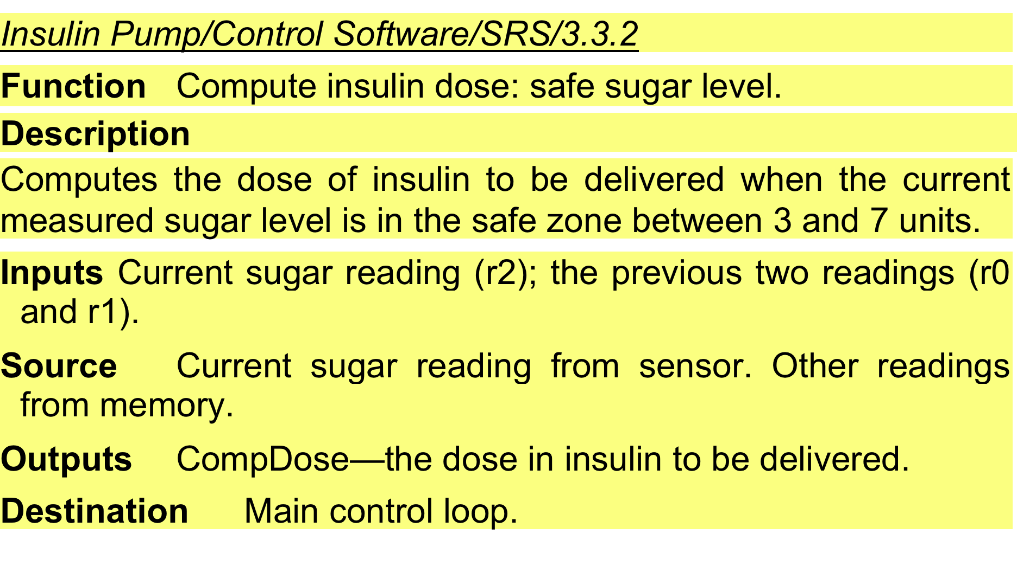
A Structured Specification of a Requirement for an Insulin Pump…

Slide 65
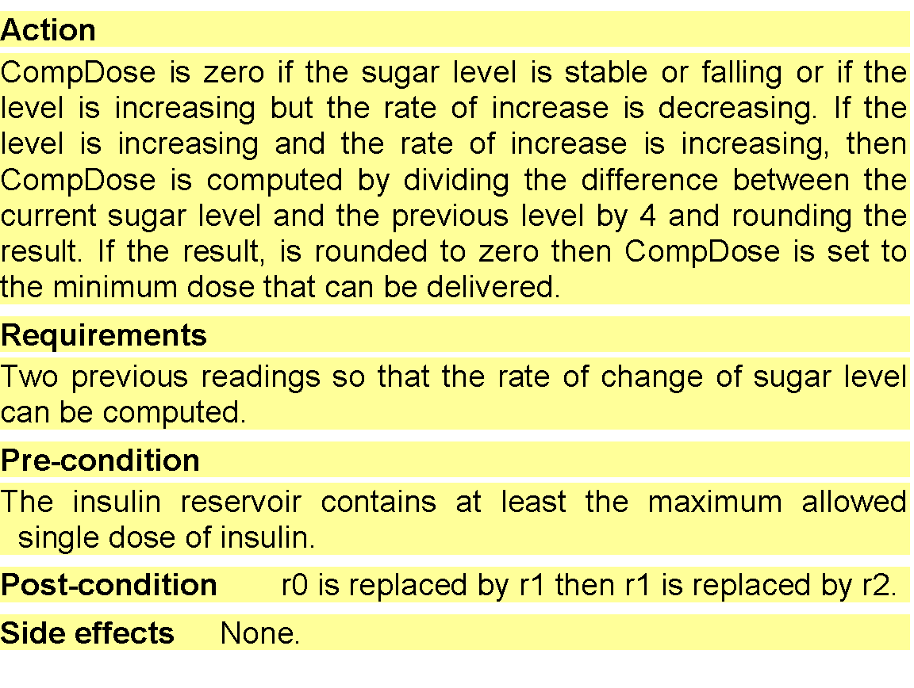
A Structured Specification of a Requirement for an Insulin Pump

Slide 66
Form-Based Specifications
Definition of the function or entity
Description of inputs and where they come from
Description of outputs and where they go to
Information about the information needed for the computation and other entities used
Description of the action to be taken
Pre and post conditions (if appropriate)
The side effects (if any) of the function

Slide 67
Template for Writing Functional Requirements
Template: Requirements Statement Example
The <user> shall be able to <capability>
The librarian shall be able to register library user
There shall be a <system function>
There shall be a library registration information facility
The <system function> shall able to <action> <entity>
The library registration information facility shall be able to store information

Slide 68
Template for Writing Non-Functional Requirements
Quality Requirements: Template Requirements Statement Example
The <user> shall be able to <capability> at a minimum rate of <quantity> times per <time unit>
The borrower shall be able to renew books at a minimum rate of 3 times per borrowing period
The <user> shall be able to <capability> within <quantity> <time unit>s from <event>
The borrower shall be able to renew books within 10 seconds from renewal process
The <system function> shall be able to <action> <entity> at least <quantity> times per <time unit>
The library registration facility shall be able to add new user information at least 15 times per minute
The <system function> shall not allow <user> to <action>
The library system shall not allow borrower to edit any sensitive data in the system

Slide 69
Tabular Specification
Used to supplement natural language
Particularly useful when you have to define a number of possible alternative courses of action
For example, the insulin pump systems bases its computations on the rate of change of blood sugar level and the tabular specification explains how to calculate the insulin requirement for different scenarios

Slide 70
Tabular Specification of Computation for an Insulin Pump
Condition | Action
Sugar level falling (r2 < r1) | CompDose = 0
Sugar level stable (r2 = r1) | CompDose = 0
Sugar level increasing and rate of increase decreasing ((r2 – r1) < (r1 – r0)) | CompDose = 0
Sugar level increasing and rate of increase stable or increasing ((r2 – r1) ≥ (r1 – r0)) | CompDose = round ((r2 – r1)/4) If rounded result = 0 then CompDose = MinimumDose

Slide 71
Use Cases
Use-cases are a scenario based technique in the UML which identify the actors in an interaction and which describe the interaction itself
A set of use cases should describe all possible interactions with the system
High-level graphical model supplemented by more detailed tabular description
Sequence diagrams may be used to add detail to use-cases by showing the sequence of event processing in the system

Slide 72
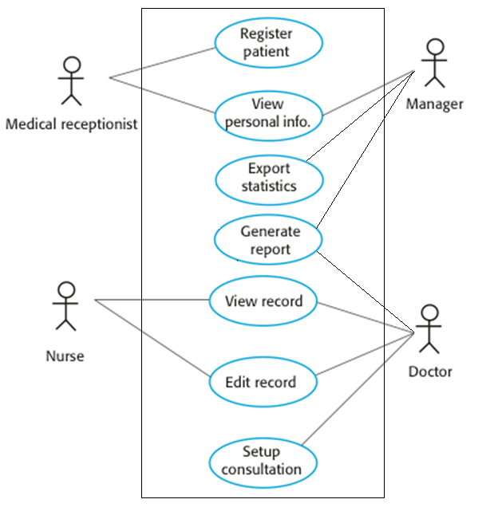
Use Case Diagram for the
Mentcare System

Slide 73
Requirements Engineering Processes
Requirements Elicitation and Analysis
Requirements Specification
Requirements Validation
Requirements Change

Slide 74
Requirements Validation
Concerned with demonstrating that the requirements define the system as what the customer really wants
Requirements error costs are high so validation is very important:
  Fixing a requirements error after delivery may cost up to 100 times the cost of fixing an implementation error

Slide 75
Requirements Checking
Validity: Does the system provide the functions which best support the customer’s needs?
Consistency: Are there any requirements conflicts?
Completeness: Are all functions required by the customer included?
Realism: Can the requirements be implemented given available budget and technology?
Verifiability: Can the requirements be checked?

Slide 76
Requirements Validation Techniques
Requirements reviews
  Systematic manual analysis of the requirements
Prototyping
  Using an executable model of the system to check requirements
Test-case generation
  Developing tests for requirements to check testability

Slide 77
Requirements Reviews
Regular reviews should be held while the requirements definition is being formulated
Both client and contractor staff should be involved in reviews
Reviews may be formal (with completed documents) or informal
Good communications between developers, customers and users can resolve problems at an early stage

Slide 78
Review Checks
Verifiability: Is the requirement realistically testable?
Comprehensibility: Is the requirement properly understood?
Traceability: Is the origin of the requirement clearly stated?
Adaptability: Can the requirement be changed without a large impact on other requirements?

Slide 79
Requirements Engineering Processes
Requirements Elicitation and Analysis
Requirements Specification
Requirements Validation
Requirements Change

Slide 80
Changing Requirements
The business and technical environment of the system always changes after installation:
  New hardware may be introduced, it may be necessary to interface the system with other systems, business priorities may change (with consequent changes in the system support required), and new legislation and regulations may be introduced that the system must necessarily abide by
The people who pay for a system and the users of that system are rarely the same people:
  System customers impose requirements because of organizational and budgetary constraints
  These may conflict with end-user requirements and, after delivery, new features may have to be added for user support if the system is to meet its goals

Slide 81
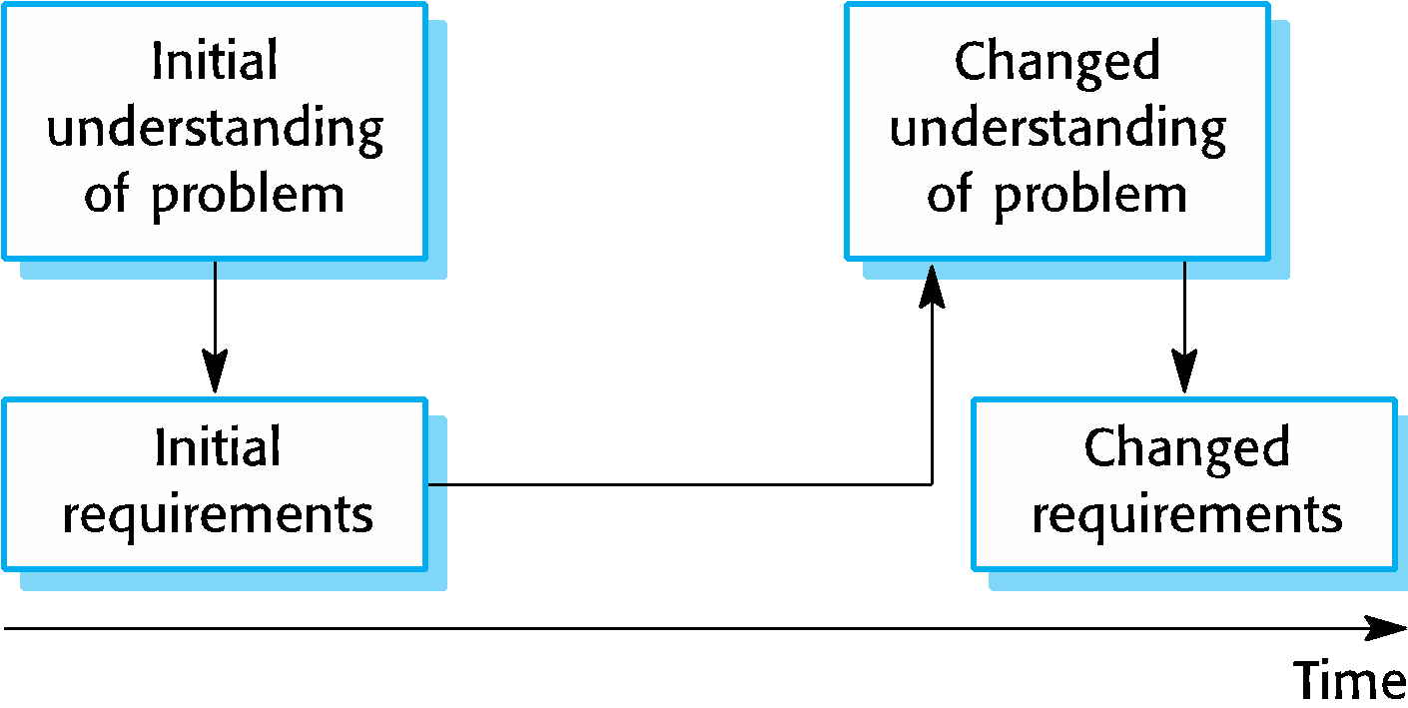
Changing Requirements
Large systems usually have a diverse user community, with many users having different requirements and priorities that may be conflicting or contradictory
The final system requirements are inevitably a compromise between them and, with experience, it is often discovered that the balance of support given to different users has to be changed
Requirements evolution

Slide 82
Requirements Management
Requirements management is the process of managing changing requirements during the requirements engineering process and system development
New requirements emerge as a system is being developed and after it has gone into use
Need to keep track of individual requirements and maintain links between dependent requirements so that you can assess the impact of requirements changes
Need to establish a formal process for making change proposals and linking these to system requirements

Slide 83
Key Points…
Requirements for a software system set out what the system should do and define constraints on its operation and implementation.
Functional requirements are statements of the services that the system must provide or are descriptions of how some computations must be carried out.
Non-functional requirements often constrain the system being developed and the development process being used.
They often relate to the emergent properties of the system and therefore apply to the system as a whole.

Slide 84
Key Points…
The requirements engineering process is an iterative process including requirements elicitation, specification and validation.
Requirements elicitation and analysis is an iterative process that can be represented as a spiral of activities – requirements discovery, requirements classification and organization, requirements negotiation and requirements documentation.

Slide 85
Key Points
Can use a range of techniques for requirements elicitation including interviews, scenarios, use-cases and ethnography.
Requirements validation is the process of checking the requirements for validity, consistency, completeness, realism and verifiability.
Business, organizational and technical changes inevitably lead to changes to the requirements for a software system. Requirements management is the process of managing and controlling these changes.

